Slide 1
Computing on a Cluster; Using Github
Lecture 5

Slide 2
Computing on a Cluster
A computer cluster is a set of loosely or tightly connected computers (nodes) that work together so that, in many respects, they can be viewed as a single system.
https://en.wikipedia.org/wiki/Computer_cluster
Notes:
https://www.breeze-software.com/services/high-speed-modeling/cluster-computing/

Slide 3
Benefits of Computing on a Cluster
Clusters are usually used to improve performance & availability over that of a single computer
They are also typically much more cost-effective than single computers of comparable speed or availability.
The concept has been around since the 1960s
Performance/Speed
providing parallel data processing and high processing capacity
Reliability/Availability
Enable data recovery in the event of a disaster
Fault tolerance (the ability for a system to continue working with a malfunctioning node)
Enables scalability
https://oit.duke.edu/help/articles/cluster-how-log

Slide 4
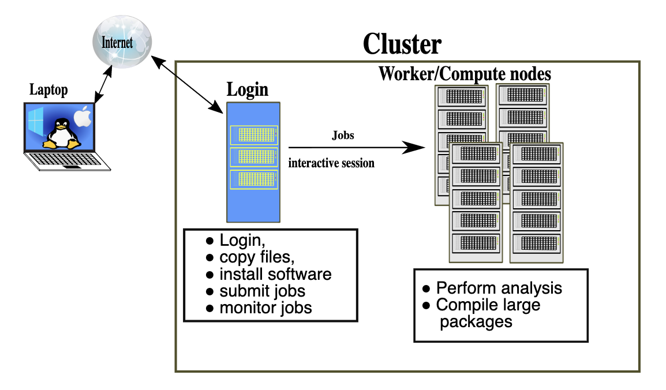
Working locally vs remotely
https://sabryr.github.io/hpc-intro/12-cluster/index.html

Slide 5
Try it yourself: Log onto the Duke Compute Cluster (DCC)
ssh YOUR_NETID@dcc-login.oit.duke.edu
& look around!
Instructions can be found here: https://dcc.duke.edu/dcc/login/

Slide 6
DCC Demo – Part 1
Connecting to and looking around the DCC

Slide 7
What is Shell Scripting?
Like writing a script in any computing language (R, Python, Matlab, etc.)
Combining a set of commands into a single text-based file, rather than typing each one individually into a command line / console
The shell executes the commands in the text file just like you had typed them in.
https://www.amazon.com/Classic-Shell-Scripting-Arnold-Robbins/dp/0596005954/ref=pd_bxgy_img_3/147-2925148-0357648?_encoding=UTF8&pd_rd_i=0596005954&pd_rd_r=bd3931c2-3d43-4fc3-9392-d93555de74bb&pd_rd_w=dtd8I&pd_rd_wg=dQHHg&pf_rd_p=09627863-9889-4290-b90a-5e9f86682449&pf_rd_r=1QN2XXTTAW6YPAQCFPW7&psc=1&refRID=1QN2XXTTAW6YPAQCFPW7
https://www.quora.com/What-is-the-difference-between-UNIX-Linux-Bash-Zsh-shell-programming-and-shell-scripting-What-is-meant-by-the-word-shell

Slide 8
Shell Scripting
shebang
#!/bin/bash # example of using arguments to a script echo "My first name is $1" echo "My last name is $2" echo "Total number of arguments is $#"
Save this file as name.sh, set execute permission on that file by typing chmod a+x name.sh and then execute the file like this: ./name.sh.
$ chmod a+x name.sh
$ ./name.sh Hans-Wolfgang Loidl
https://www.macs.hw.ac.uk/~hwloidl/Courses/LinuxIntro/x945.html

Slide 9
DCC Demo – Part 2
Shell Scripting

Slide 10
DCC Demo – Part 3
Submitting jobs to the cluster

Slide 11
put, get, wget
Put, get:
Moving files to and from the cluster from your local drive
Wget, curl
Downloading files from the internet to a remote server (e.g. the cluster)

Slide 12
DCC Demo – Part 4
Moving files between the cluster and your local machine

Slide 13
Github
Recall that we use version control and code sharing software to support reproducible data science!

Slide 14
What is GitHub?
GitHub is an open-source repository hosting service for code.
Variety of different programming languages
Keeps track of the various changes made to every iteration by using git, a revision control system that runs in the command line interface
Notes:
Source: https://www.thebalancecareers.com/what-is-github-and-why-should-i-use-it-2071946

Slide 15
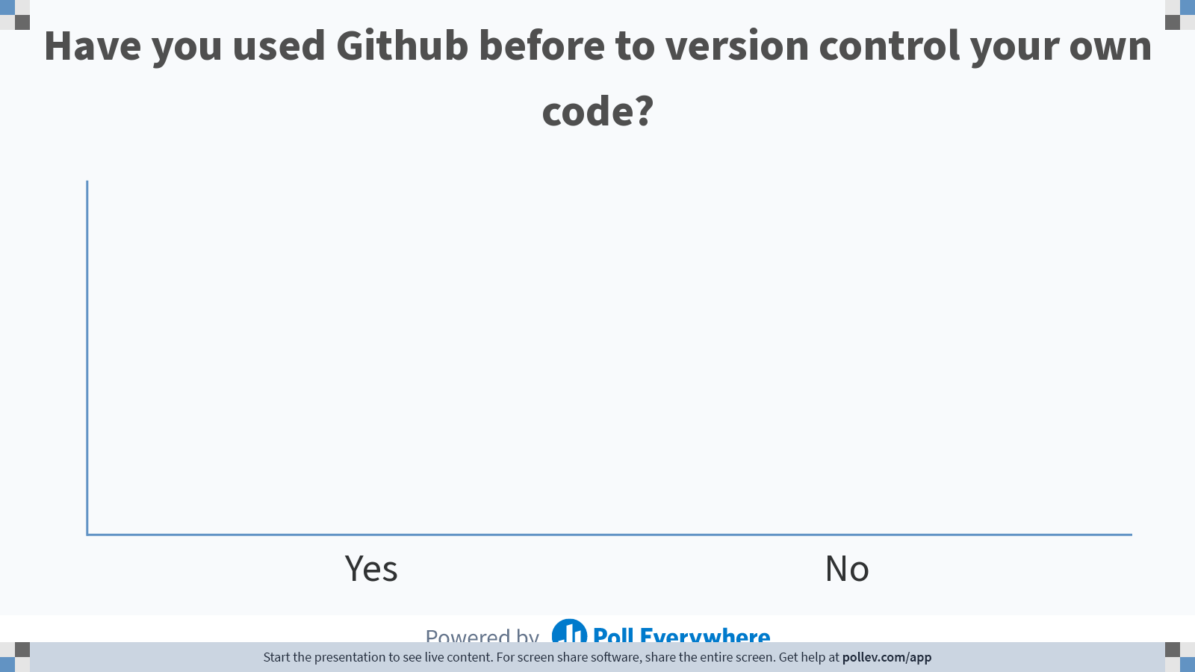
Notes:
Do not modify the notes in this section to avoid tampering with the Poll Everywhere activity. More info at polleverywhere.com/support Have you used Github before to version control your own code?
https://www.polleverywhere.com/multiple_choice_polls/ElBqTIzb6xVxC5LxLnB7D

Slide 16
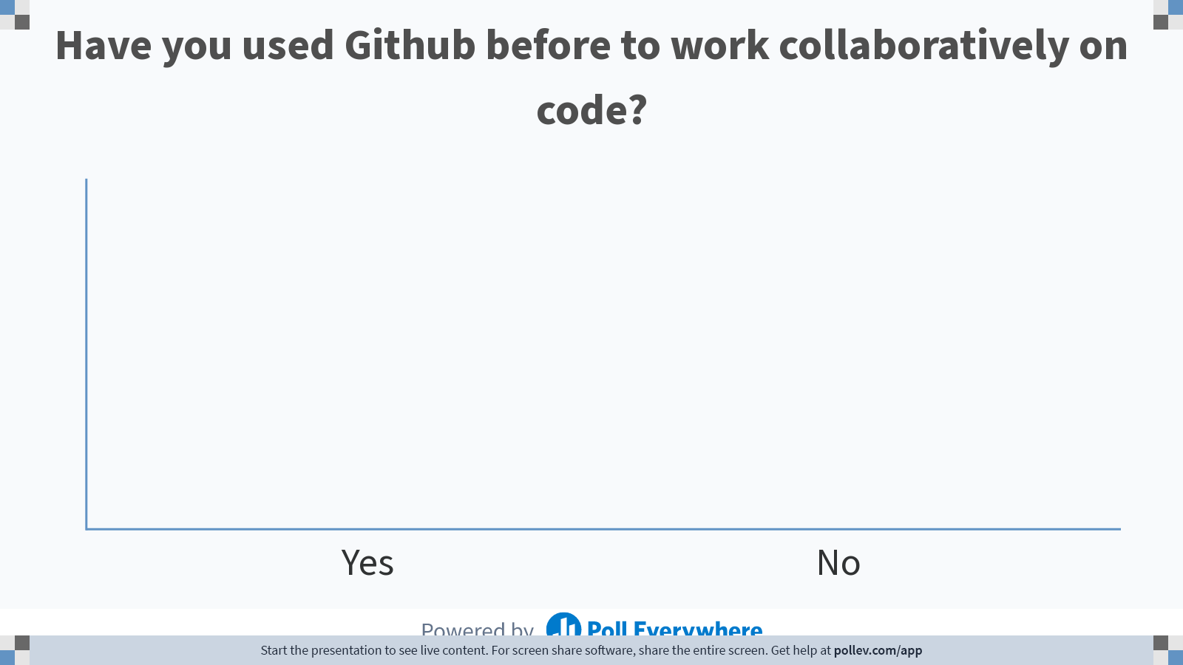
Notes:
Do not modify the notes in this section to avoid tampering with the Poll Everywhere activity. More info at polleverywhere.com/support Have you used Github before to work collaboratively on code?
https://www.polleverywhere.com/multiple_choice_polls/9qtv6zls09b0ZX3qtm4rP

Slide 17
Why should I be using GitHub?
> 28 million users- huge network!
Allows for easy collaborations
Trackable
Enables you to become active in the community
Improve your attractiveness as a job candidate (a public portfolio of your work as a data scientist!)
~1GB/repository (file <50-100MB)

Slide 18
Two Scenarios for Using Git
you want to track your own project
you want to start working on someone else’s project

Slide 19
Where we organize what we want to commit to our repository
https://github.com/fedosejev/front-end-course/blob/master/week-01/day-01/learn-git.md

Slide 20
Git Commands
git config --global [user.name] [user.email]
init
status
add [-filename] [-A]
reset [-filename]
Commit -m
log

Slide 21
Cloning a remote repo
clone <url> <local place to clone>
remote –v
branch –a
diff
push [origin master]
pull
Try cloning the repository at https://github.com/jessilyn/BME590_practice
Add your name to the readme file

Slide 22
Reminders & Upcoming Deadlines
Homework #1 is due Tuesday (1/31/2023)
If you have questions about the homework, please reach out to your TA first
Quiz #1 is next Tuesday (1/31/2022) during class
Your project groups are due the following Thursday (2/2/2023)
Please reach out to me if you are having trouble finding a group

Slide 23
Examples of Projects from Last Semester
Predicting Adolescent Self-Perceived Health using Data Collected by the Minnesota Department of Public Health
Exploring the Relationship Between Mental Health and Heart Disease
Using Natural Groupings of Sepsis Status to Improve Sepsis Prediction
Inference and Prediction of Breast Cancer Mortality by National U.S. Greenspace Measures
Predicting Mortality of ICU Patients Utilizing Various Classification Methods

